Slide 1
Product Detector
Find genuine/fake product by scanning QR code on the bottle scratch label

Slide 2
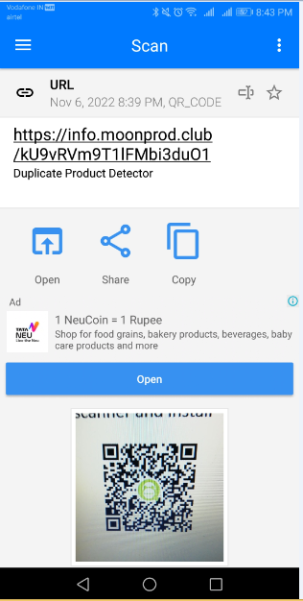
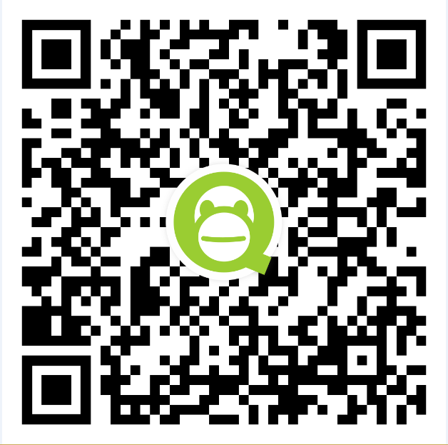
Find Genuine Product
After scratch label on the bottle and scan with QR code scanner in your mobile. If do not have QR code scanner then go to “Google Play Store” type QR code scanner and install “QR Code Scanner”.
Scan then open. If it’s genuine product then display below page.

Slide 3
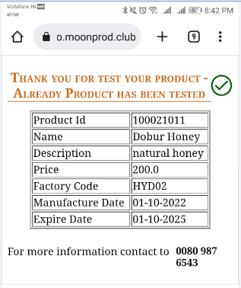
Genuine Product Screen

Slide 4
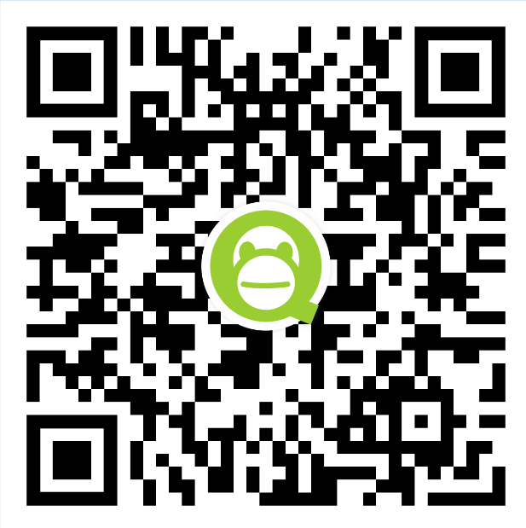
Find Fake Product
After scratch label on the bottle and scan with QR code scanner in your mobile. If do not have QR code scanner then go to “Google Play Store” type QR code scanner and install “QR Code Scanner”.
Scan then open. If it’s fake product then display below page.

Slide 5
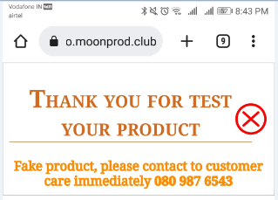
Fake Product Screen

